Slide 1
L4/5 GROUP 13
Amy Potter
Sean Turner
Alex Mednick
Alex Turnbull

Slide 2
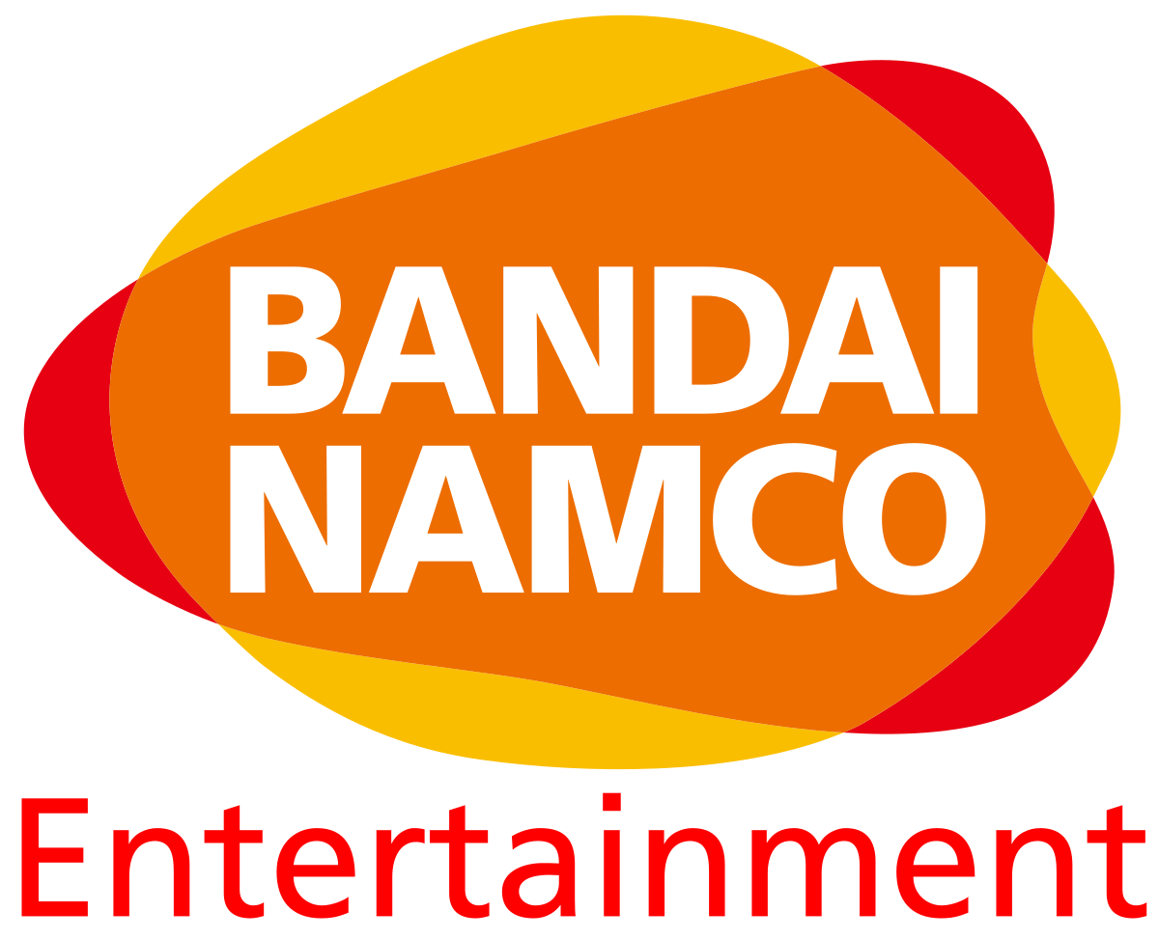

The Brief
Adversarial
Turn based
Symmetric gameplay
AP

Slide 3
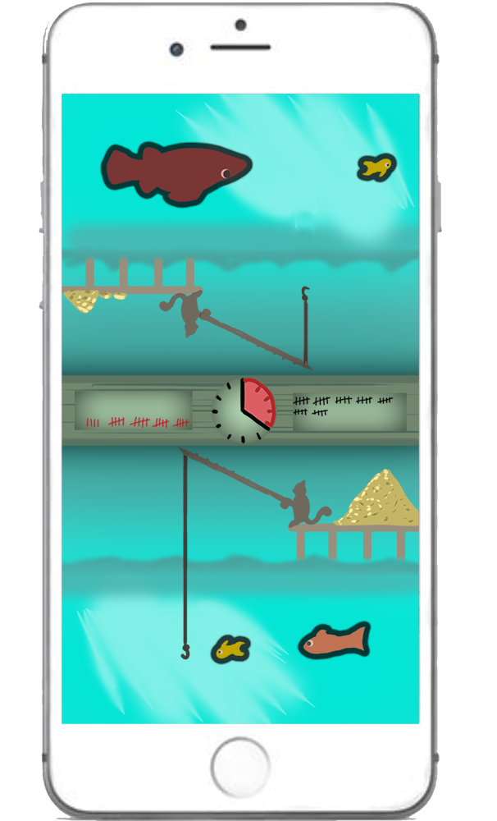
Market Overview Logline/Target audience/platform etc.
Two players compete to catch the greatest haul of fish and avoid being zapped by jellyfish.
Platform – Mobile
Casual/mid-core gamers
Female
21-35 age range
AP
Notes:
http://developers.magmic.com/demographic-breakdown-casual-mid-core-hard-core-mobile-gamers/
http://www.gamerefinery.com/games-competitive-landscape-categorize/
http://www.theesa.com/wp-content/uploads/2017/09/EF2017_Design_FinalDigital.pdf

Slide 4
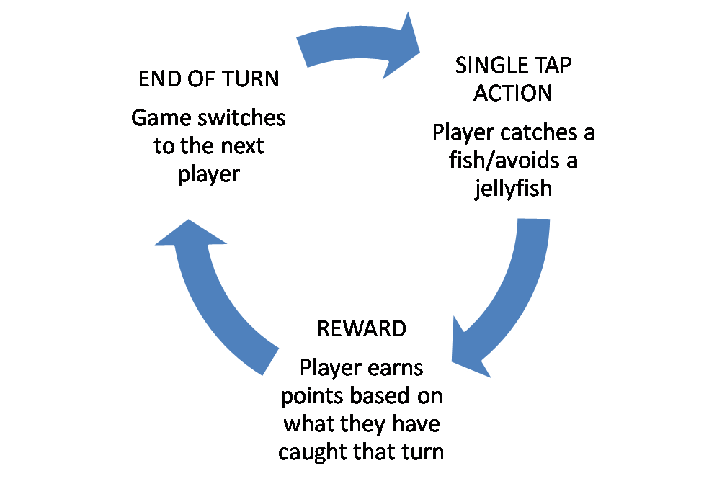
What Does the Player Do? Core Game Loop
AT
Notes:
Catch fish to increase your score and beat your opponent – watch out for jellyfish!

Slide 5
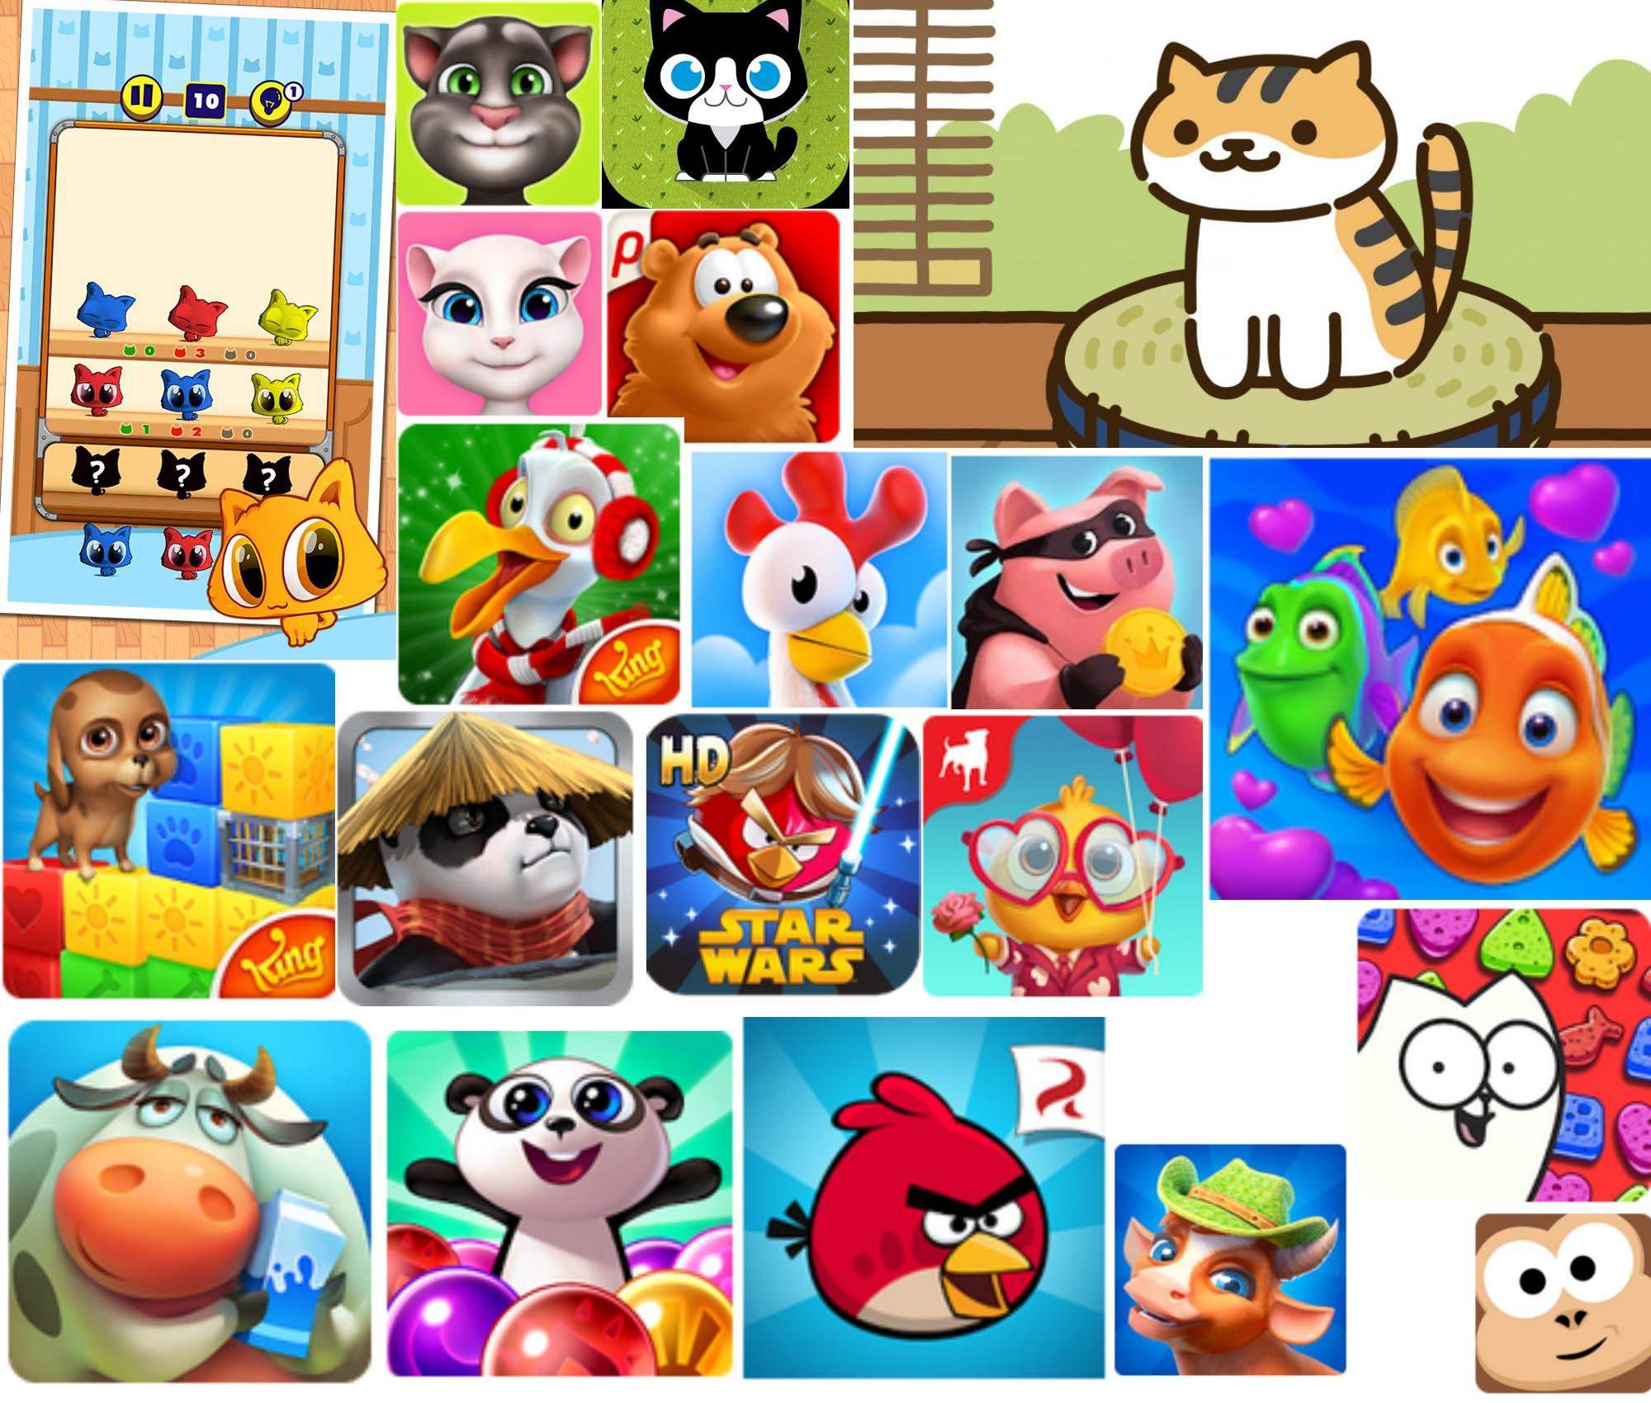
Research
Games
WarioWare
Fruit Ninja
Badland
Market trends
Animals are popular
Stylised to be cute, anthropomorphised features
AM + ST
Notes:
For the character designs, I have researched popular mobile games on the Google Play Store. I found that animal characters are common, for example in Angry Birds and Toon Blast. They are usually stylised to be cute, or have anthropomorphised features such as clothes. Having a cute main character will also generate emotional empathy in players more easily, as they will want to take care of it.

Slide 6
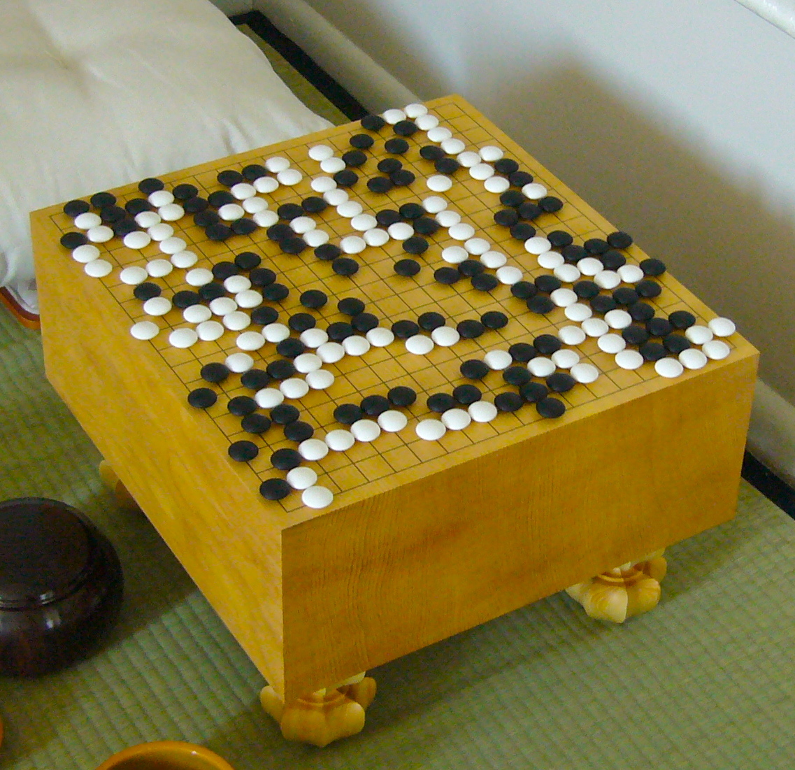
Player Experience Mechanics, Gameplay; Types of fun etc.
Easy to learn, hard to master
Offensive/defensive play
People fun
Competition
Doesn’t require a lot of skill
Cognitive and sensory immersion
AM
Notes:
The gameplay mechanics are simple and intuitive, with only a single action the player can take in their turn. Reeling in the fishing line can be used both offensively and defensively, to avoid a jellyfish or push your opponent into one, as well as catching fish to score.
We will aim to create immersion using the visuals and audio, so that players are fully focused and engaged. Then we can create the strong competitive emotional responses such as schadenfreude and fiero.

Slide 7
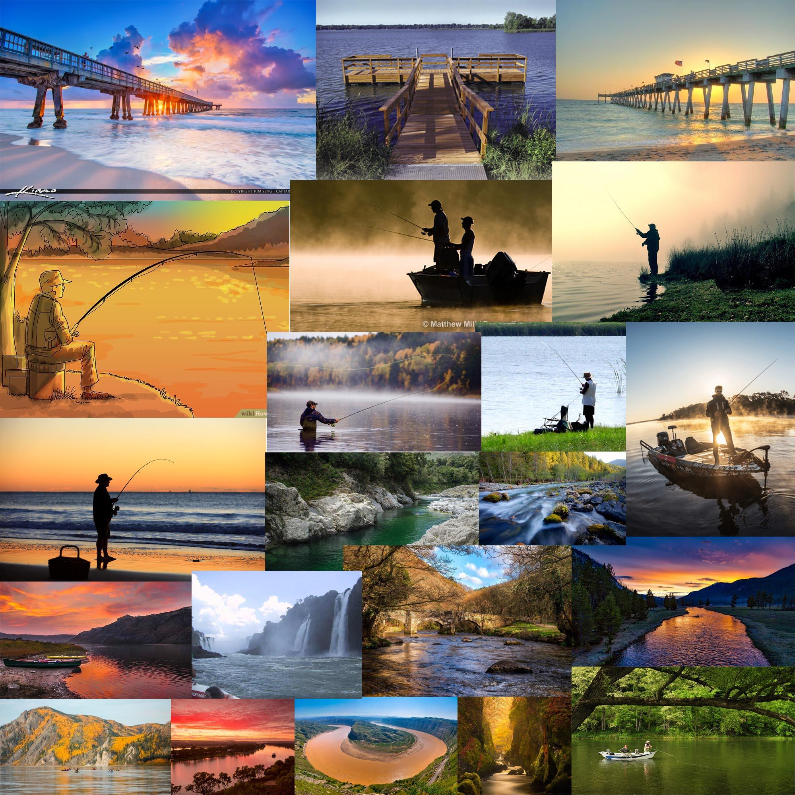
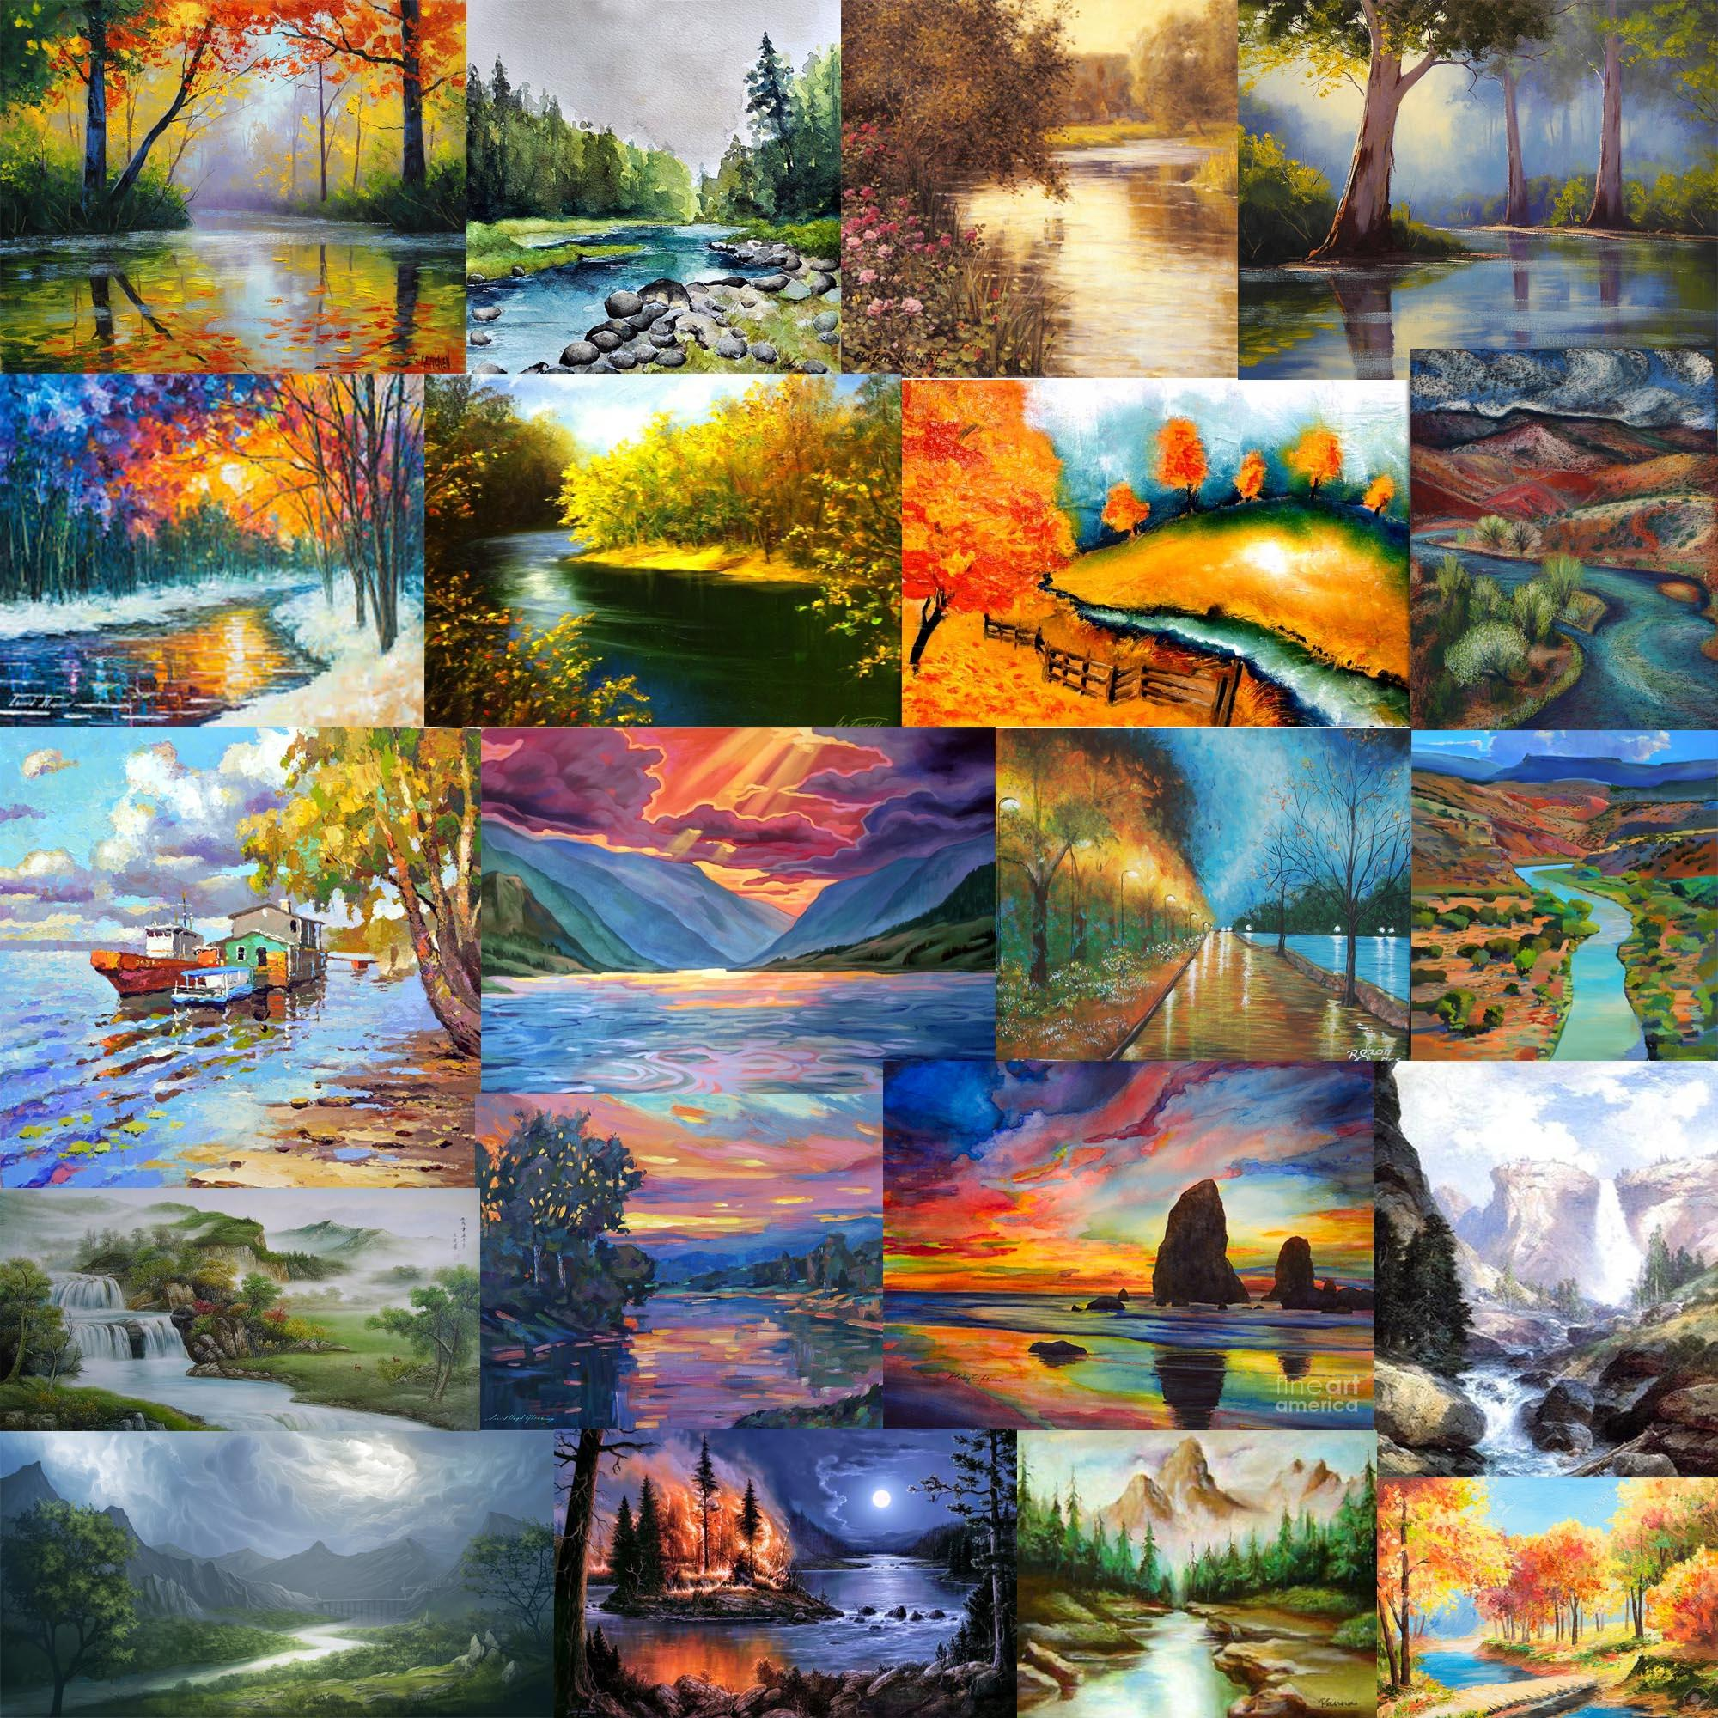
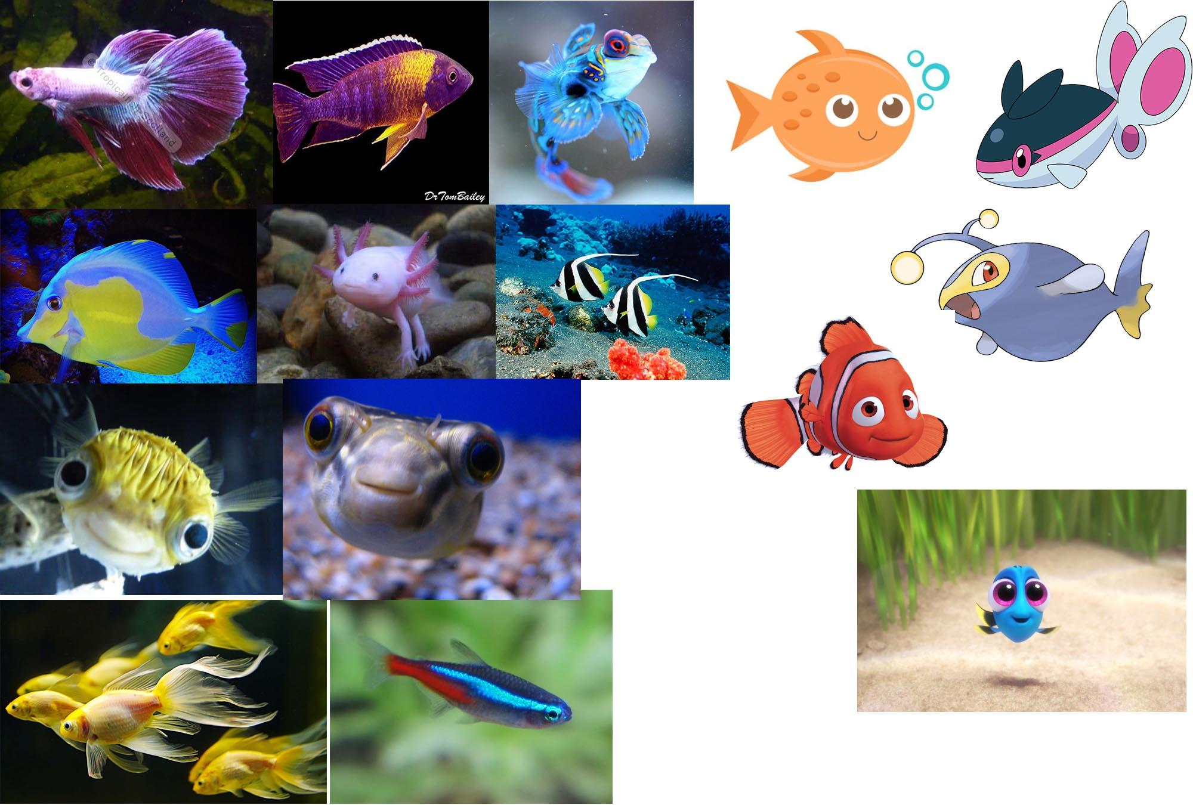
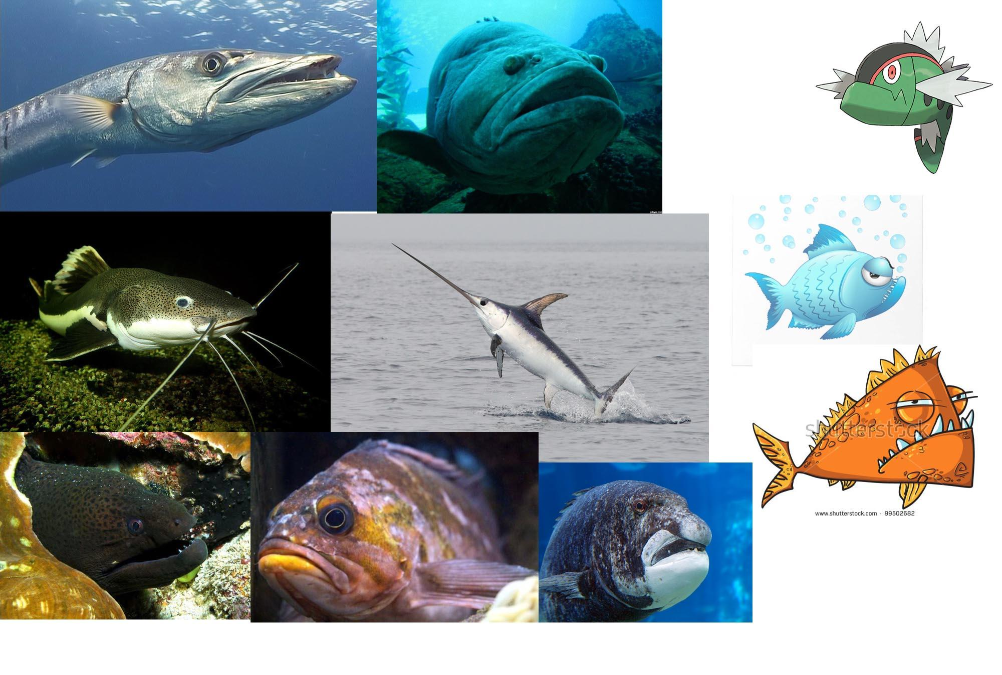
Art style/moodboards
ST
Notes:
I have been gathering moodboards for the style of the game, so that it can be given a unique and interesting aesthetic.

Slide 8
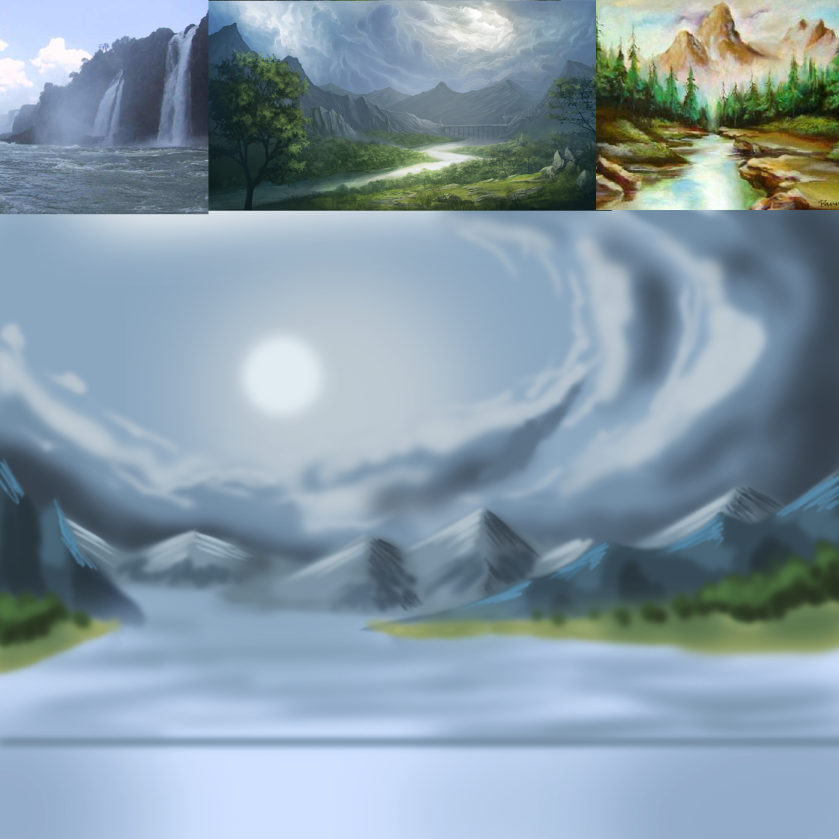
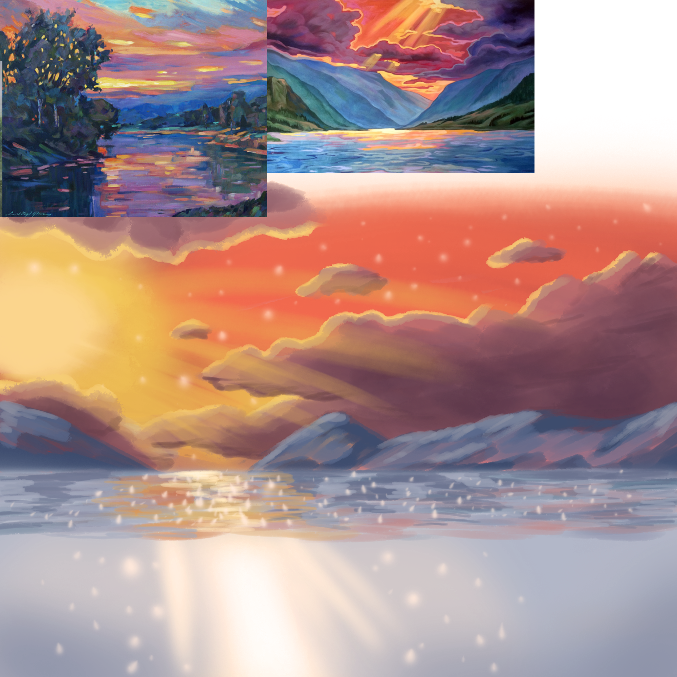
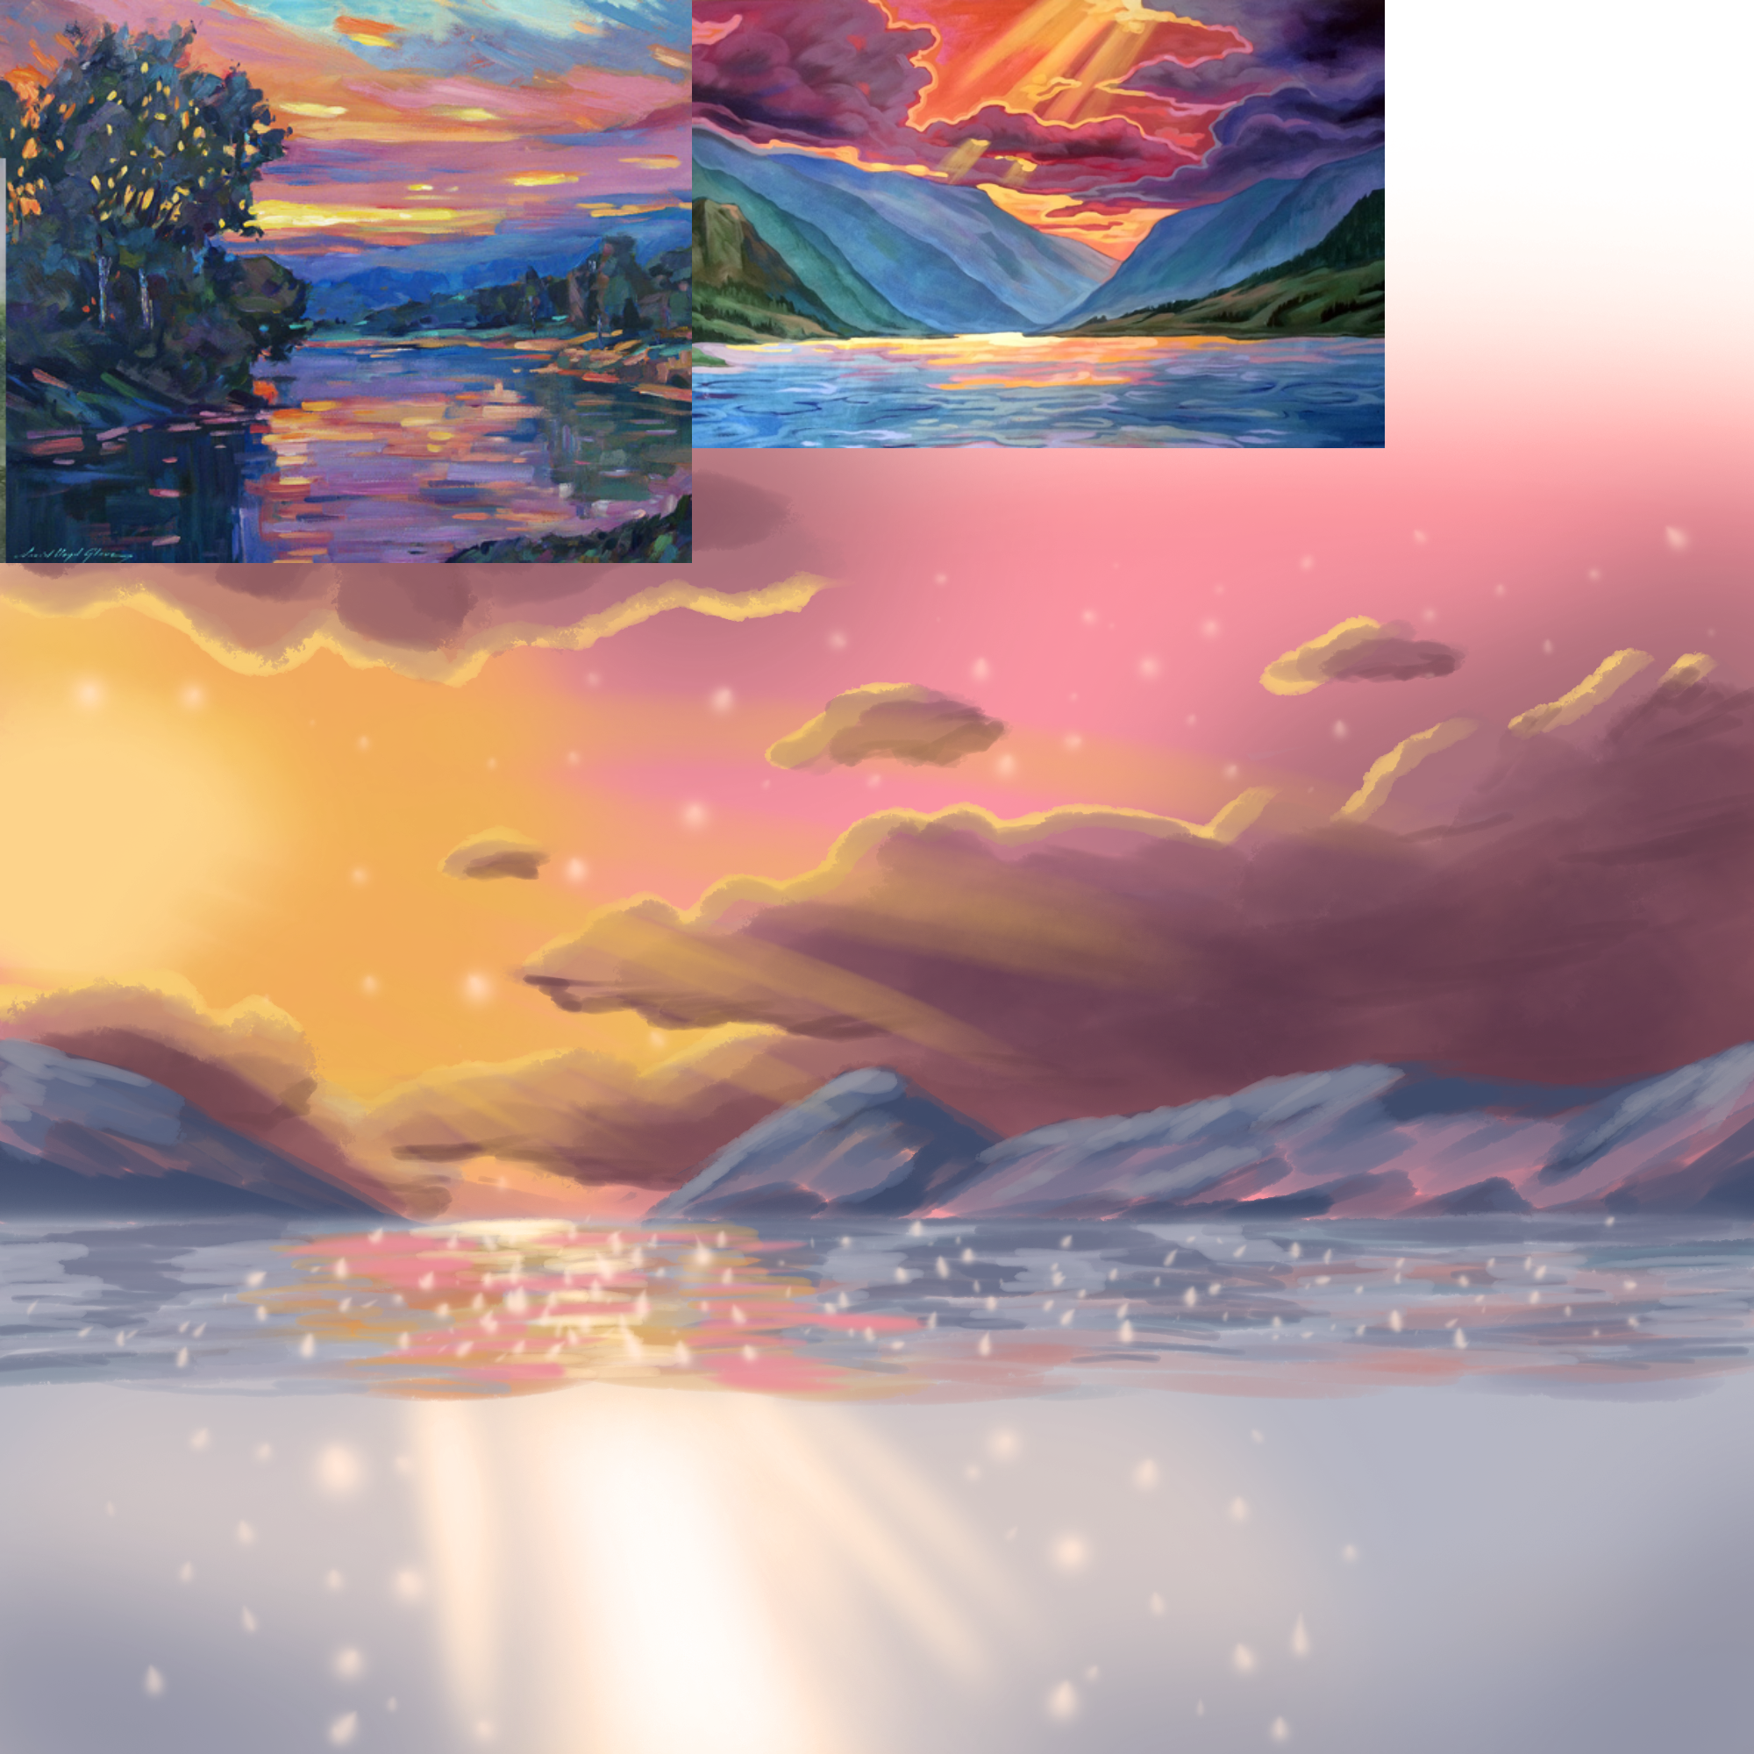
Art style/moodboards
Starting to experiment with styles for the background
ST
Notes:
The tone of the setting hasn’t been decided yet - I will do more market research to see what will appeal most to the audience. I’m experimenting with creating wonder using sparkles on the water and in the sky.

Slide 9
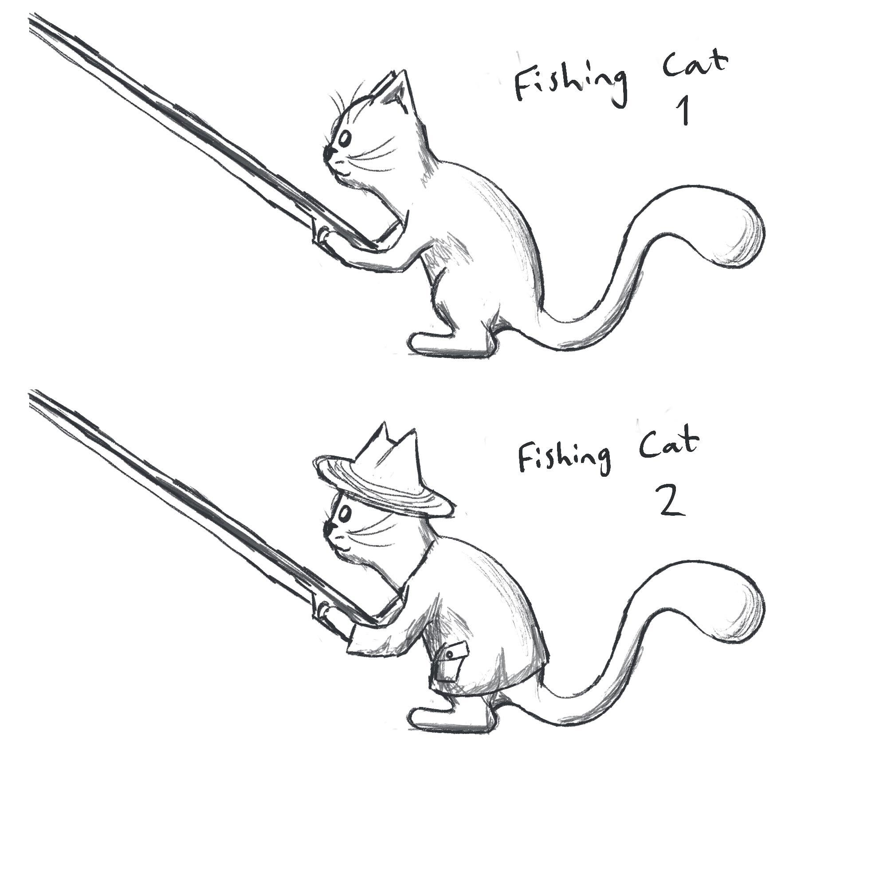
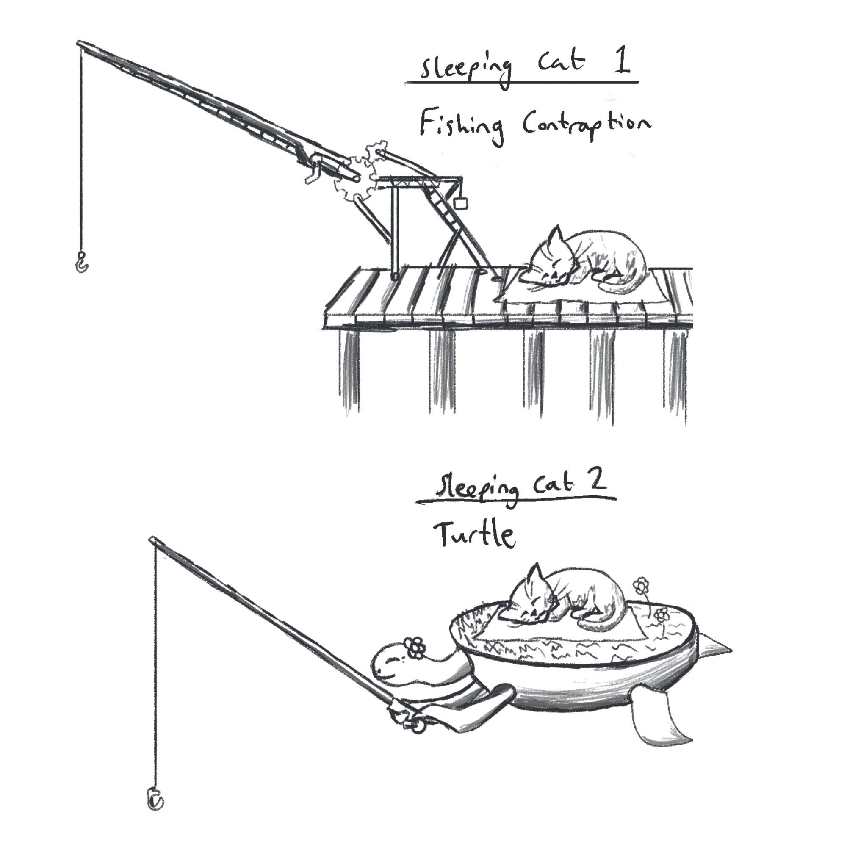
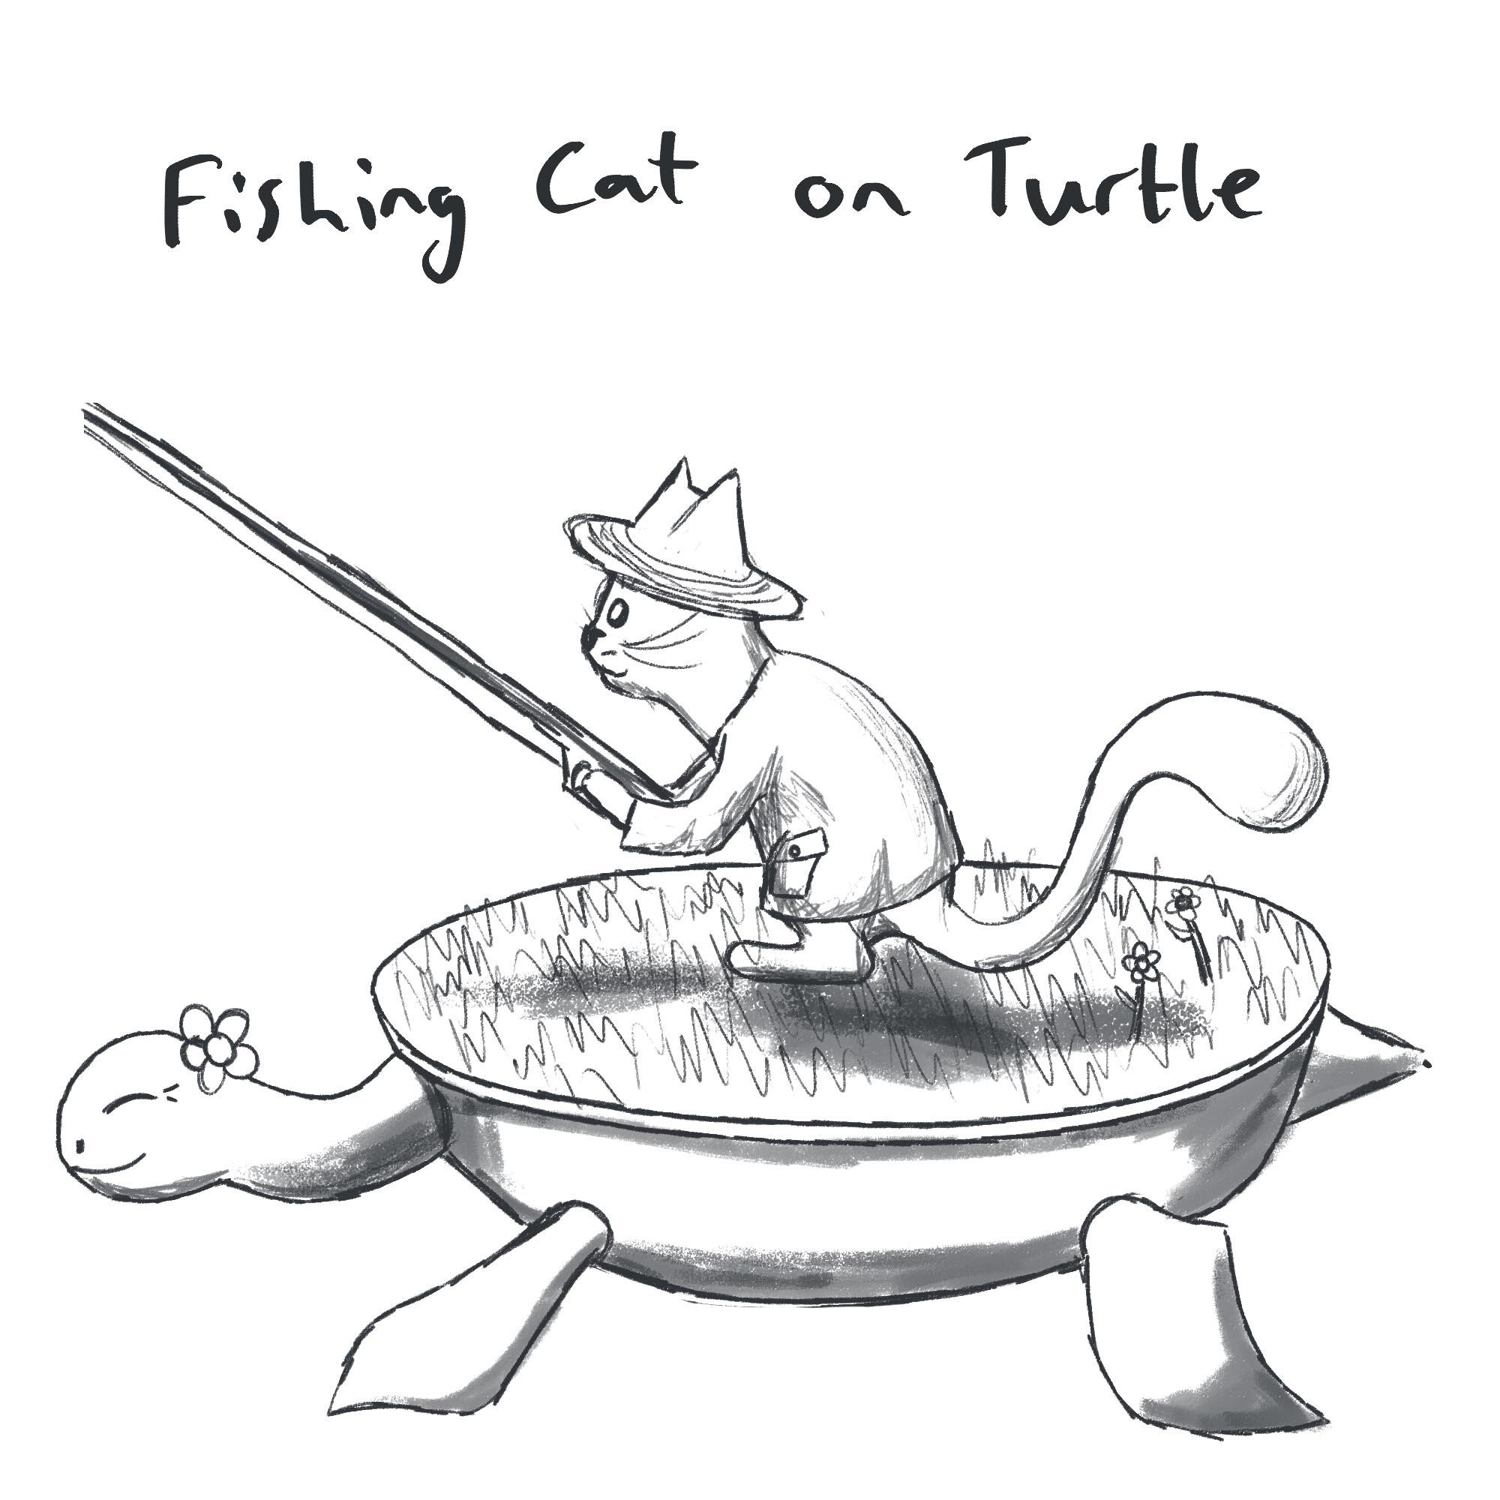
Initial Concept Drawings Exploring a cat as the main character
ST
Notes:
Cats seemed like the obvious choice, as they are very popular cute animals, and they also eat fish. I’ve tried anthropomorphising cats and making them do the fishing, as well as having other things fish for them. I quite like the turtle character idea, as it adds a kind of parent-child relationship between the characters.

Slide 10
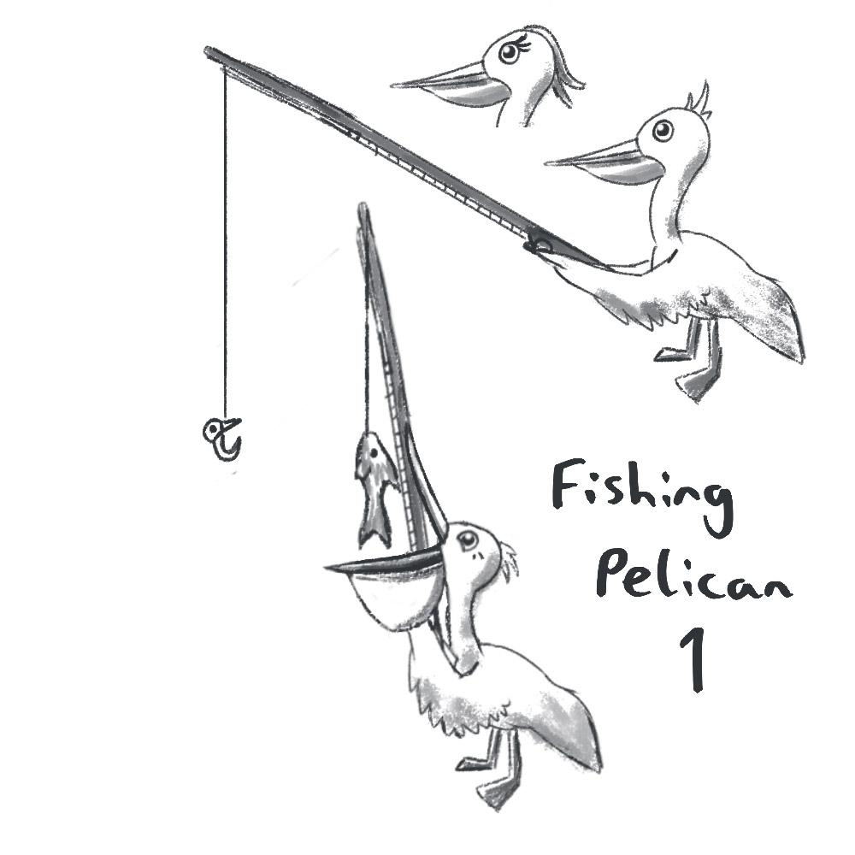
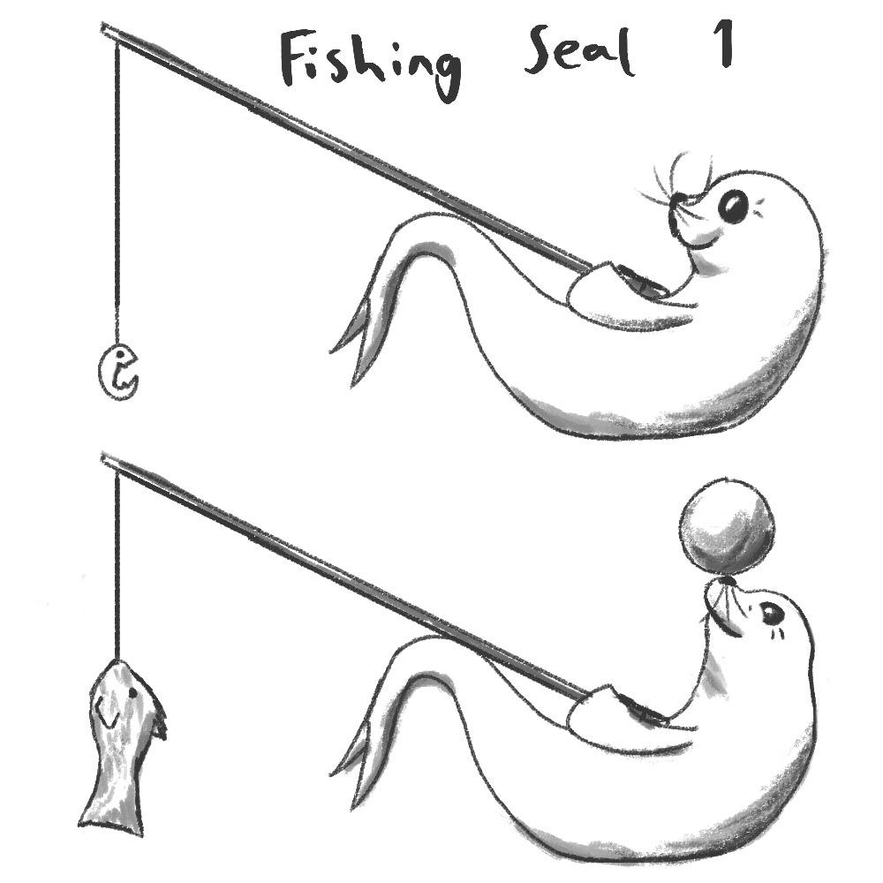
Initial Concept Drawings Other Animals
ST
Notes:
I’ve also started some other designs than the cat. I’m making them cute by enlarging the eyes to give a look of innocence, and by simplifying details. As with the background, the final decision on which character to use will be made based on target audience research.

Slide 11

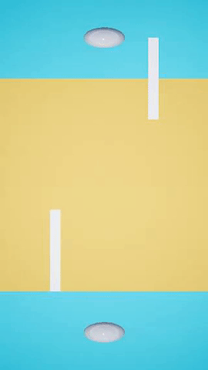
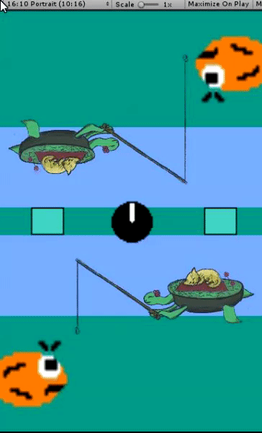

Prototype
AM + AT
Notes:
Unreal: Simple prototype made using basic shapes to represent the different elements in the game, using a single input to control both of the players rods - raising the rod of the player who just went and lowing the second player’s so it becomes their turn to catch We each took an engine and built a prototype to see which engine would jump out as most appropriate for the project. Unity lends itself very well to 2D development and android deployment. At this point neither has gameplay mechanics implemented other than moving line.

Slide 12
Questions?

